Slide 1




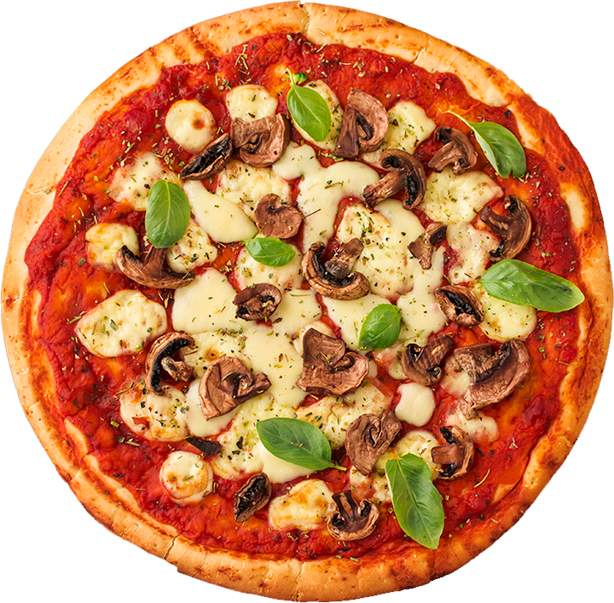

Fradel and Spies
Product Presentation
Premium Pizza Innovation
Presented By:
www.reallygreatsite.com
Garvita Gupta

Slide 2

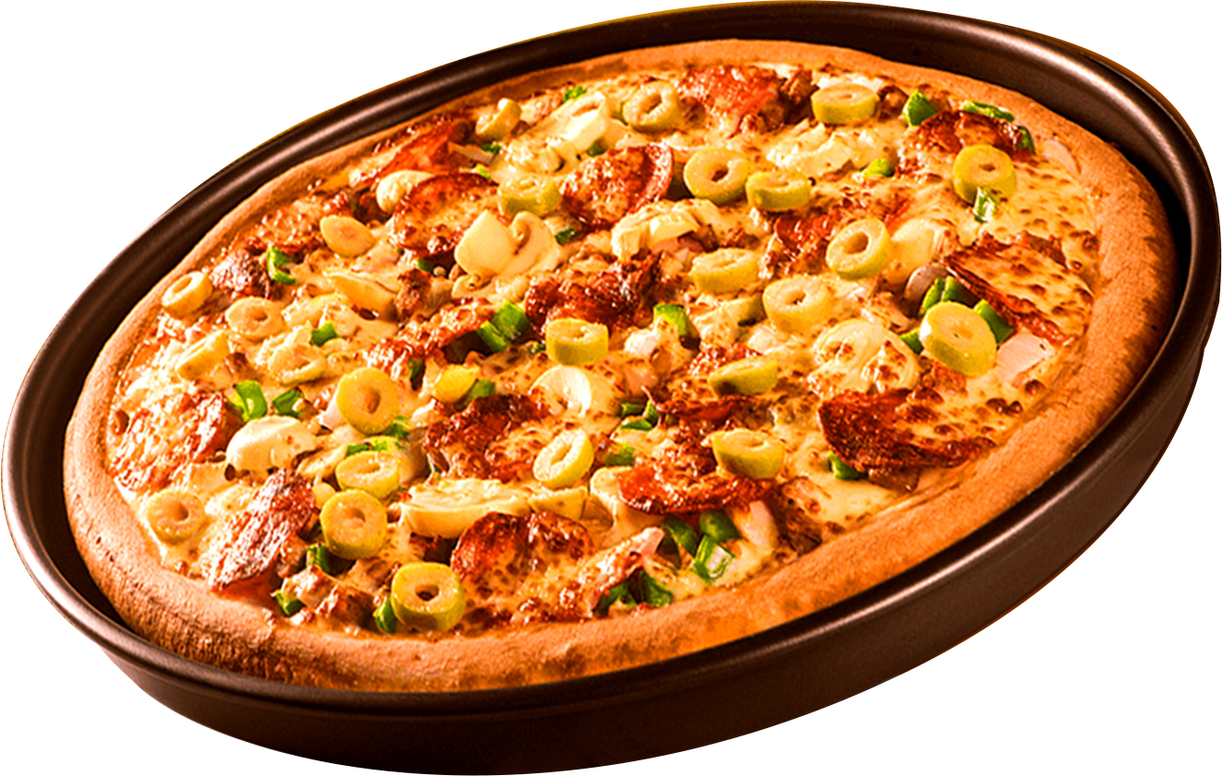


Fradel and Spies
Introduction
Pizza has always been one of the most beloved dishes worldwide, combining simple ingredients with irresistible flavors. Our new product takes pizza to the next level by combining authentic techniques with modern culinary innovation. Designed for pizza lovers of all ages, our product delivers a superior taste experience that’s both comforting and exciting.
@reallygreatsite

Slide 3


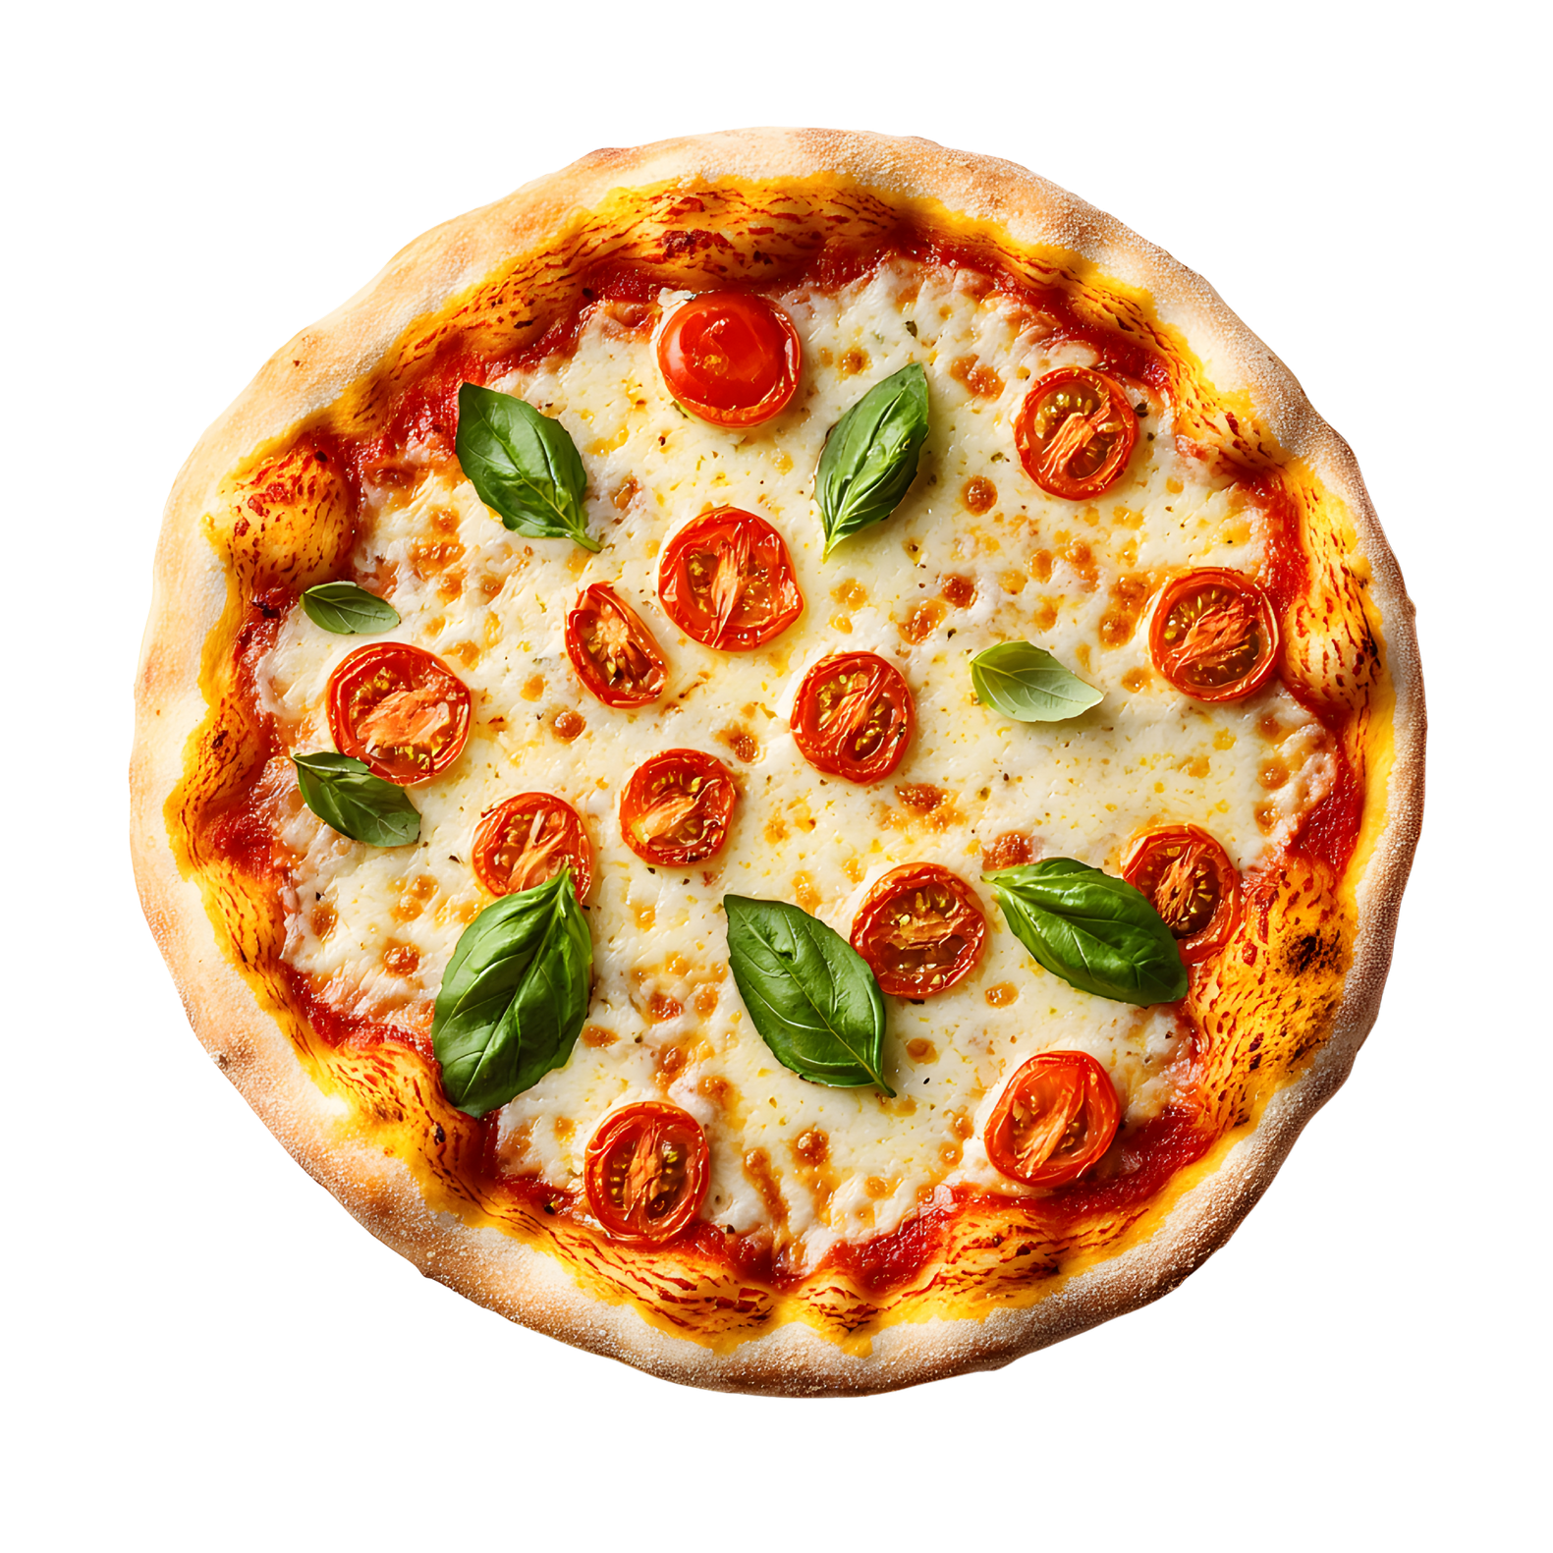
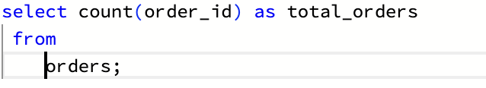
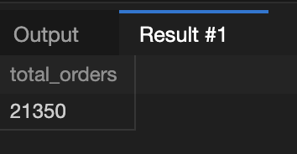
Retrieve the total number of orders placed.

Slide 4
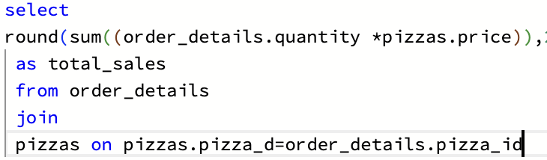
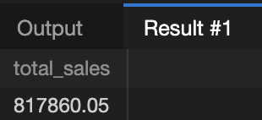
Calculate the total revenue generated from pizza sales.

Slide 5
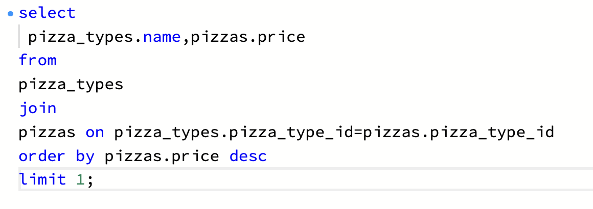
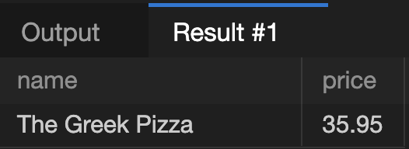
Identify the highest-priced pizza.

Slide 6
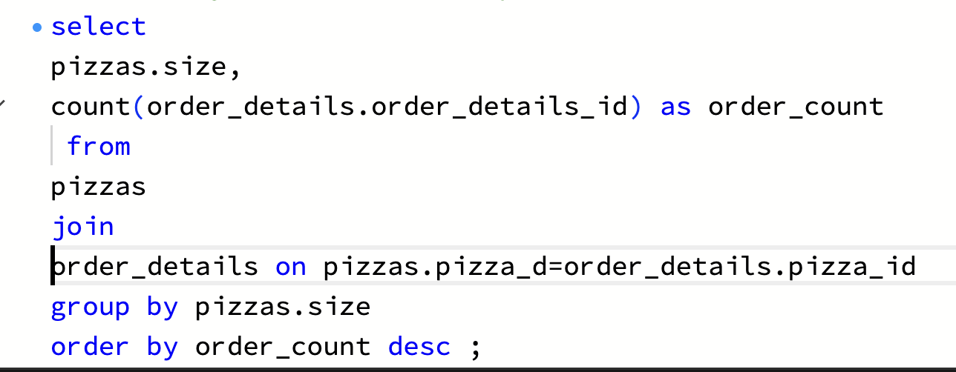
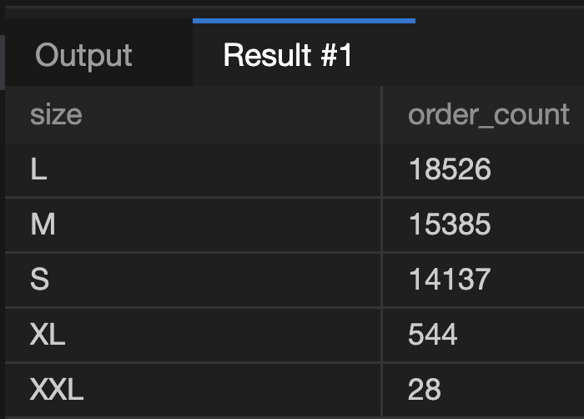
Identify the most common pizza size ordered.

Slide 7
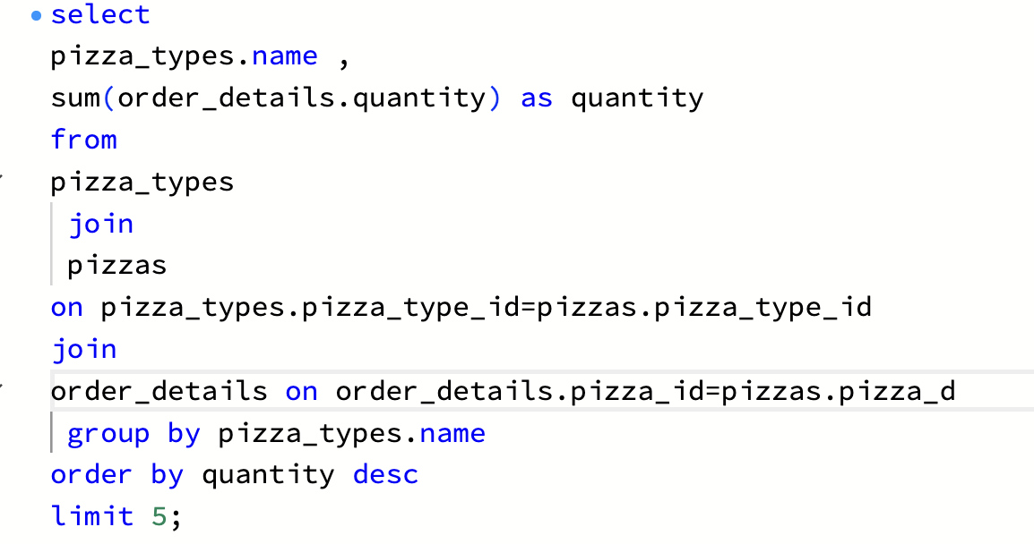
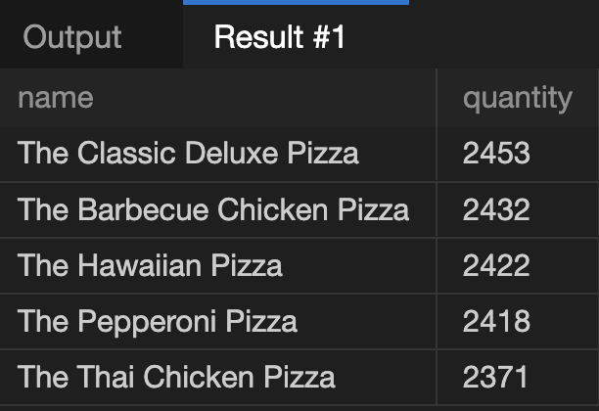
List the top 5 most ordered pizza types along with their quantities.

Slide 8
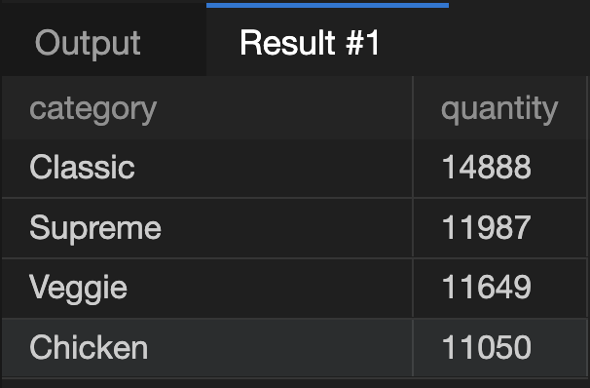
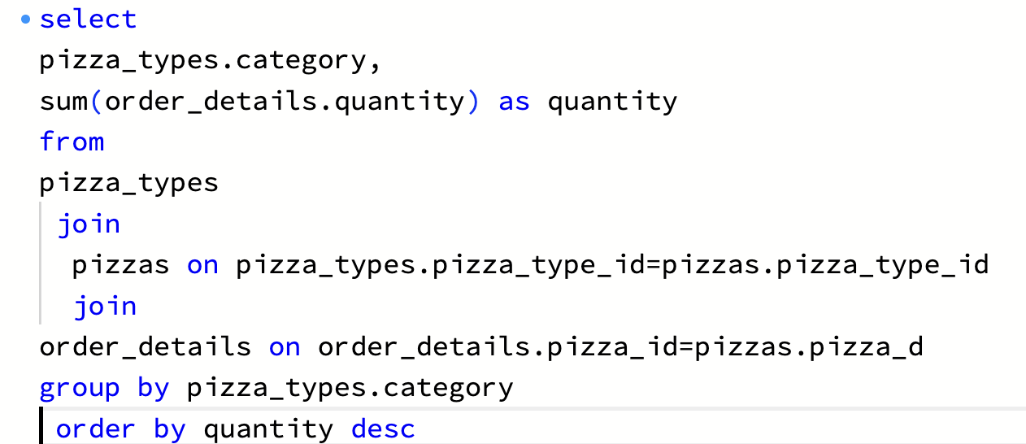
Join the necessary tables to find the total quantity of each pizza category ordered.

Slide 9
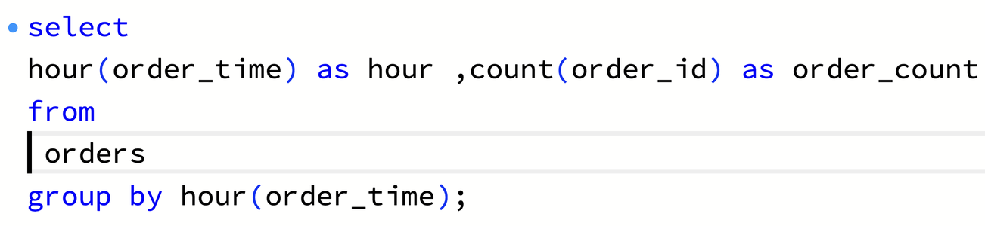
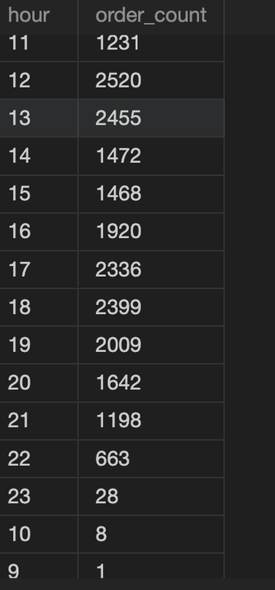
Determine the distribution of orders by hour of the day.

Slide 10
Join relevant tables to find the category-wise distribution of pizzas.

Slide 11
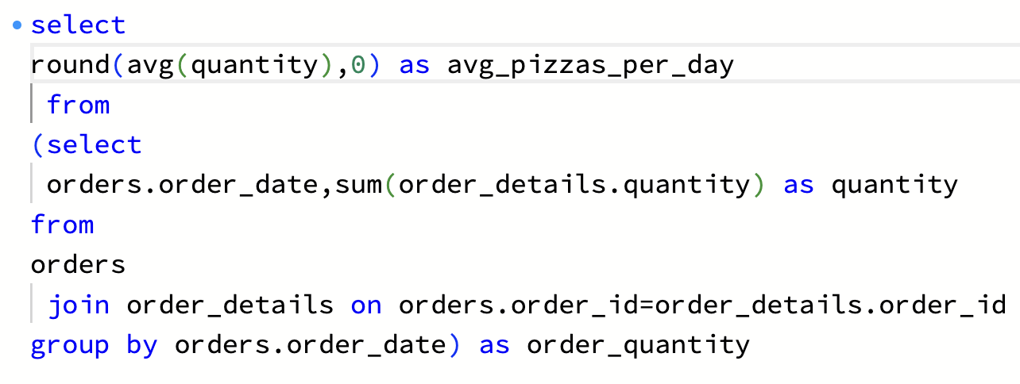
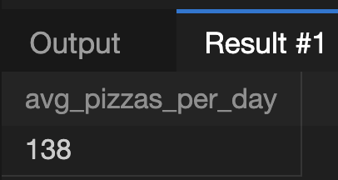
Group the orders by date and calculate the average number of pizzas ordered per day.

Slide 12
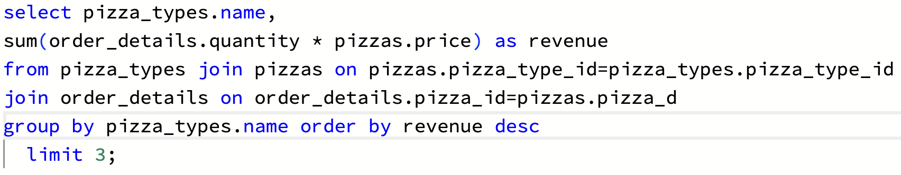
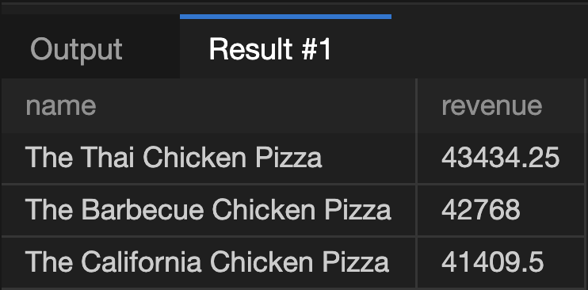
Determine the top 3 most ordered pizza types based on revenue.

Slide 13
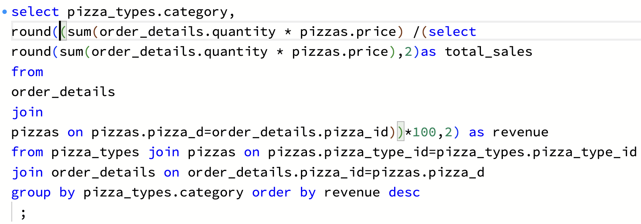
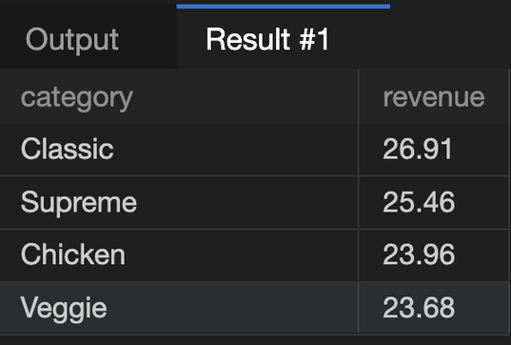
Calculate the percentage contribution of each pizza type to total revenue.

Slide 14
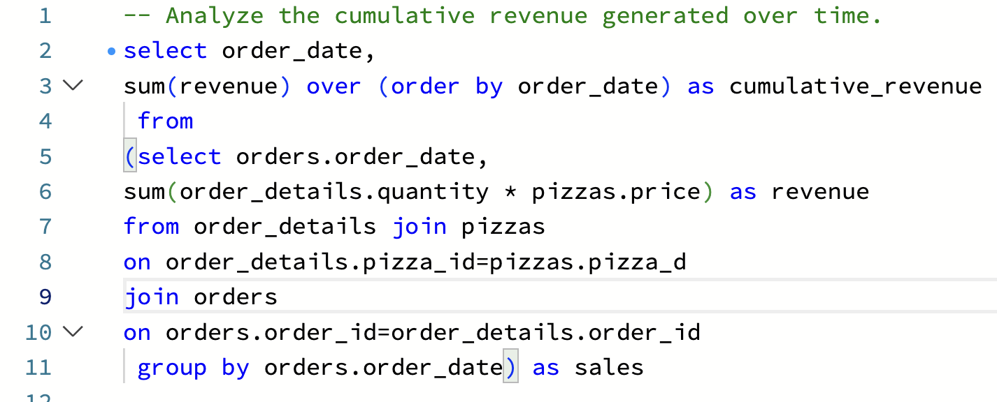
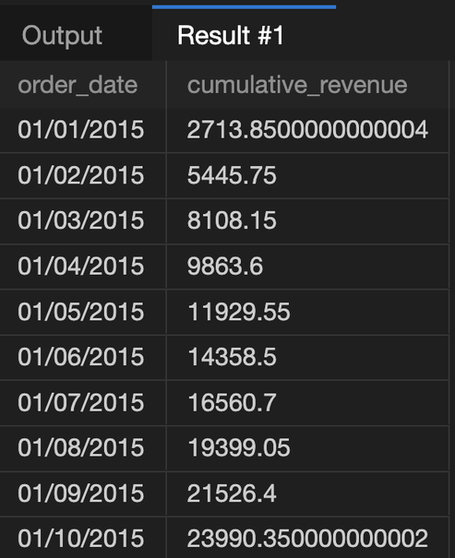
Analyze the cumulative revenue generated over time.

Slide 15
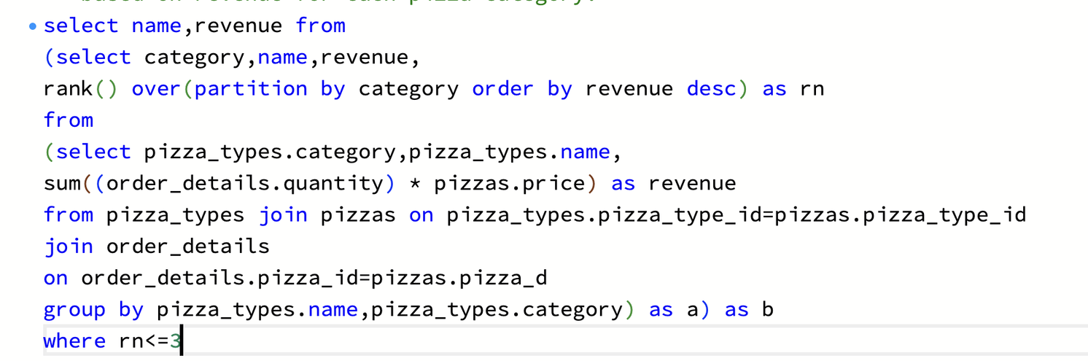
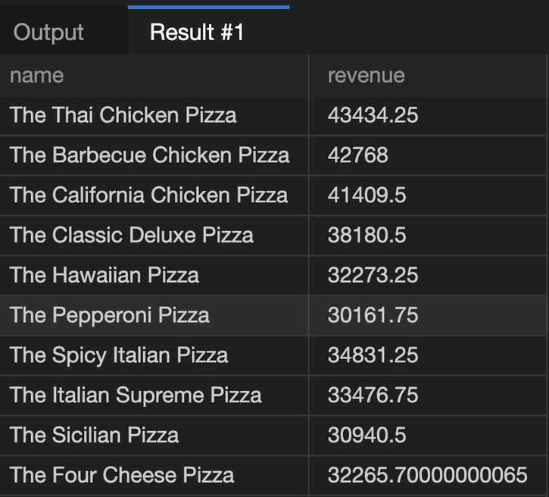
Determine the top 3 most ordered pizza types based on revenue for each pizza category.

